Slide 1

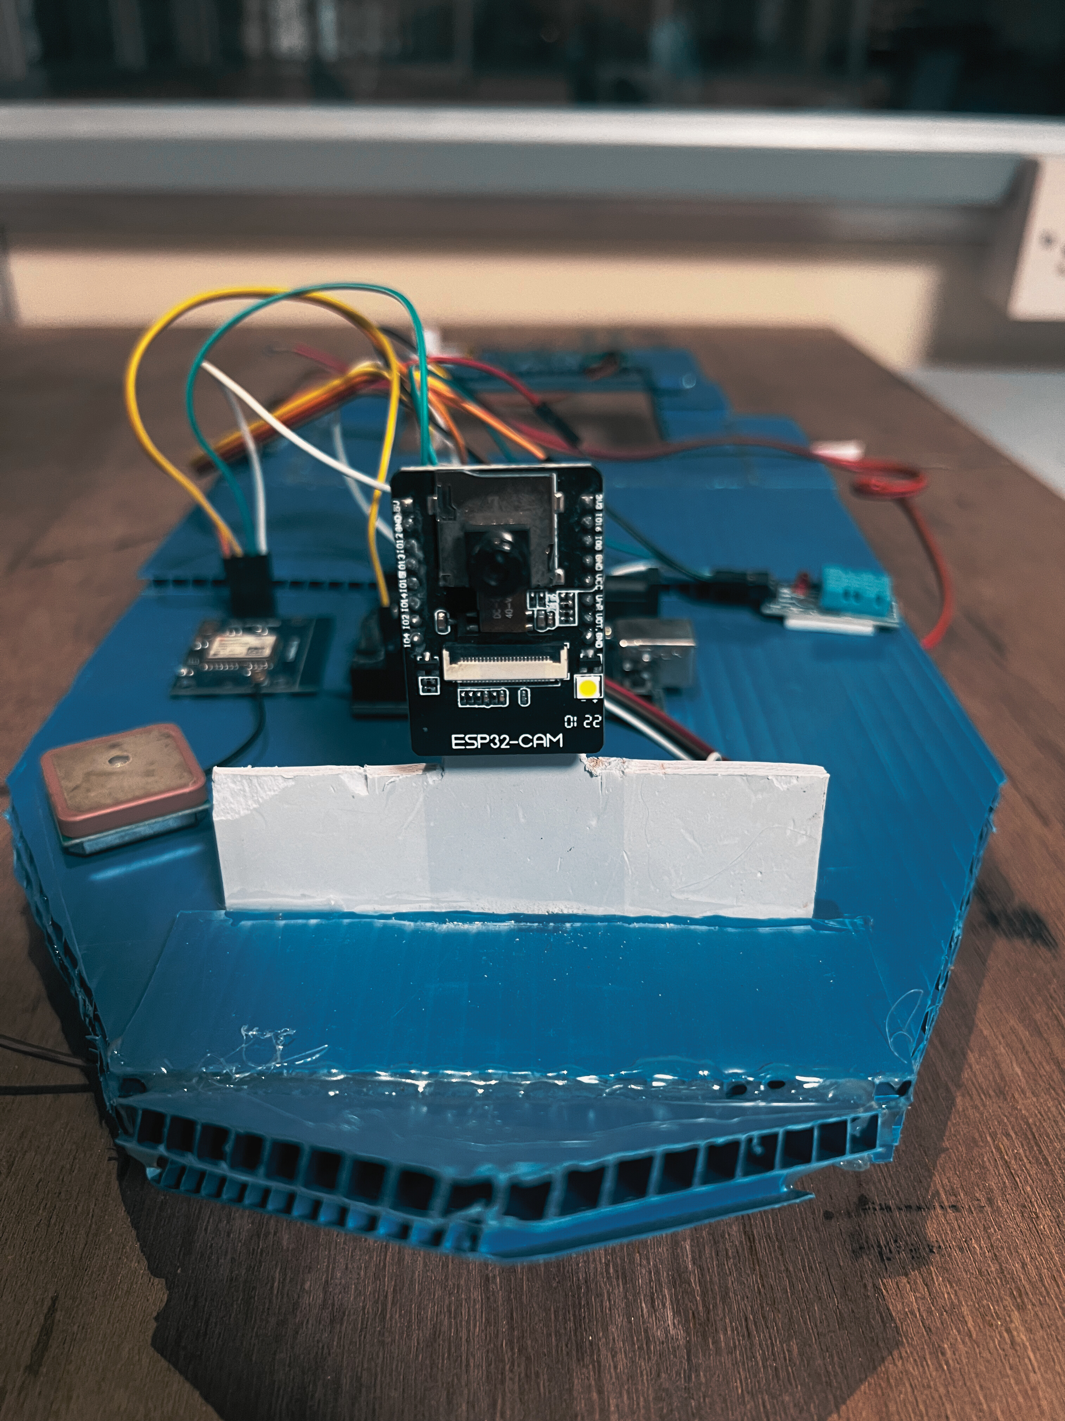

ECE DEP
METROAT
PRESENTED BY
THE TITANS
MURUGESAN.A
SARAN.S
RAHUL.A

Slide 2

ABSTRACT
The METROAT is a portable and compact device which will be a major player in minimizing the destruction of roads in order to detect and restore the water flow in the city. The craft helps us get an insight into the situation underground. The device can be controlled remotely by the person standing on the road. The data collected will be stored in cloud which can be used for future reference. The design of the device is elegant and crisp. It can maneuver easily through the bends and pipes and detect the clogs and leaks in pipe.

Slide 3
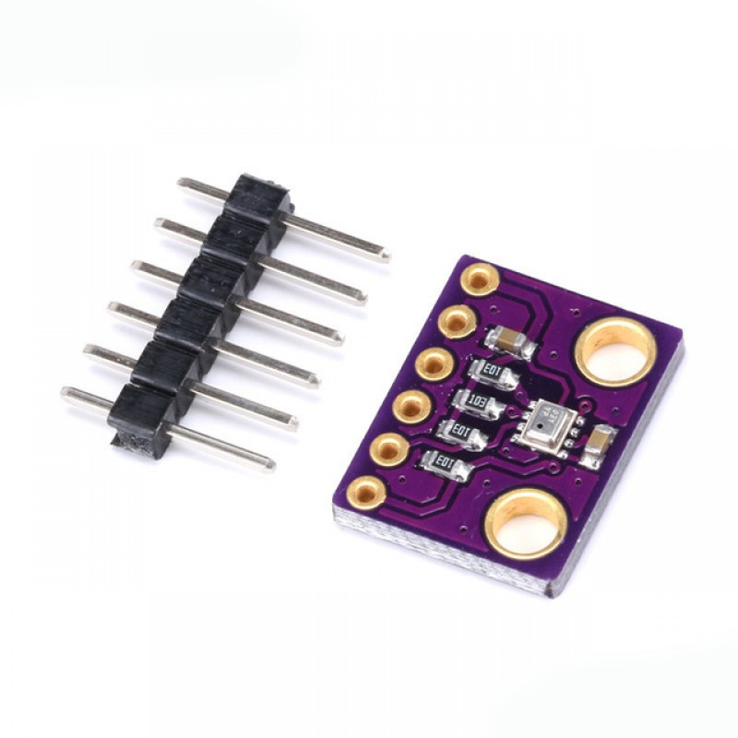
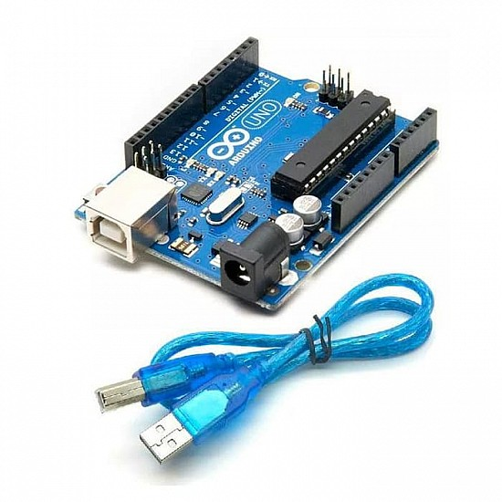
COMPONENTS OF THE CRAFT
A BASE STRUCTURE (BOAT)
ARDUINO UNO R3
PIC MICROCONTROLLER, SOIL MOISTURE SENSOR
ESP32CAM MODULE
PRESSURE SENSOR BMP280
TEMPERATURE SENSOR DHT-11
GPS MODULE NEO 6M

Slide 4
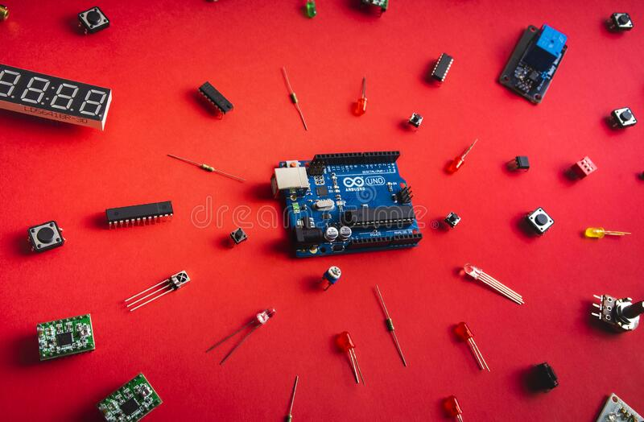

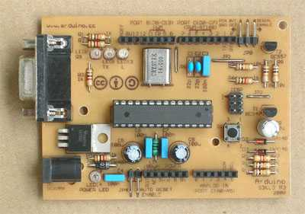
HOME MADE ARDUINO PCB
Step 1: Alter the Changes in the Original Schematic. ...
Step 2: Gather the Components Required. ...
Step 3: Draw the Final Schematic. ...
Step 4: Design the PCB and Paste it on Cu board .
Step 5: Solder the Components on the PCB. ...
Step 6: Burn the Bootloader on the Microcontroller. ...
Step 7: Program the Arduino (using FTDI Breakout Board)
Arduino is an open-source electronics platform based on easy-to-use hardware and software. Arduino boards are able to read inputs - light on a sensor, a finger on a button, or a Twitter message - and turn it into an output - activating a motor, turning on an LED, publishing something online.

Slide 5

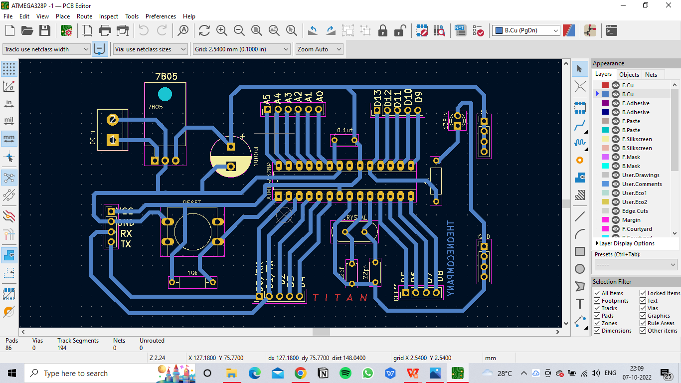
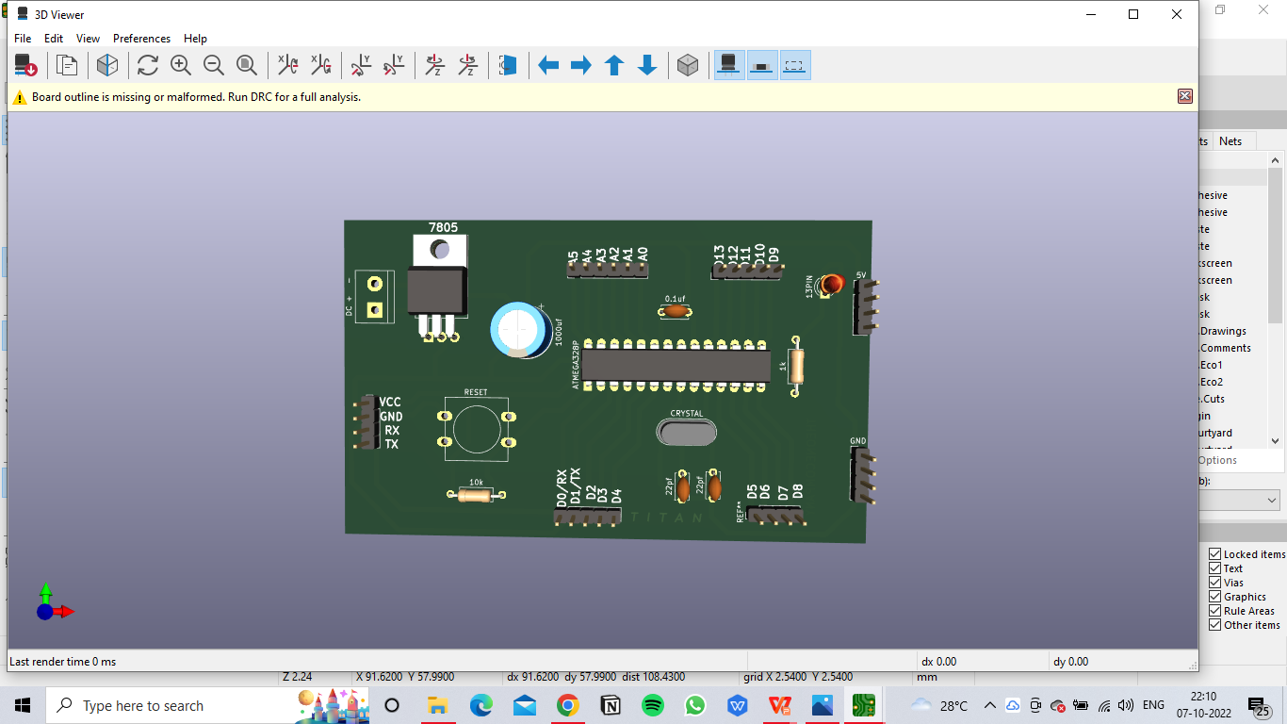
FERRIC CHLORIDE ETCHING IN CU BOARD

Slide 6
WORKING
Through a manhole the device is lowered into the pipe .
The device then moves towards the defect .
The device uses CAM module to detect things and the data is intrpreted by the controller.
According to the data received the device is handled
Once the clog is detected, with the help of the GPS module at the exact location of the clog, the road is dug and the pie can be fixed.
Now the water flow is restored.

Slide 7
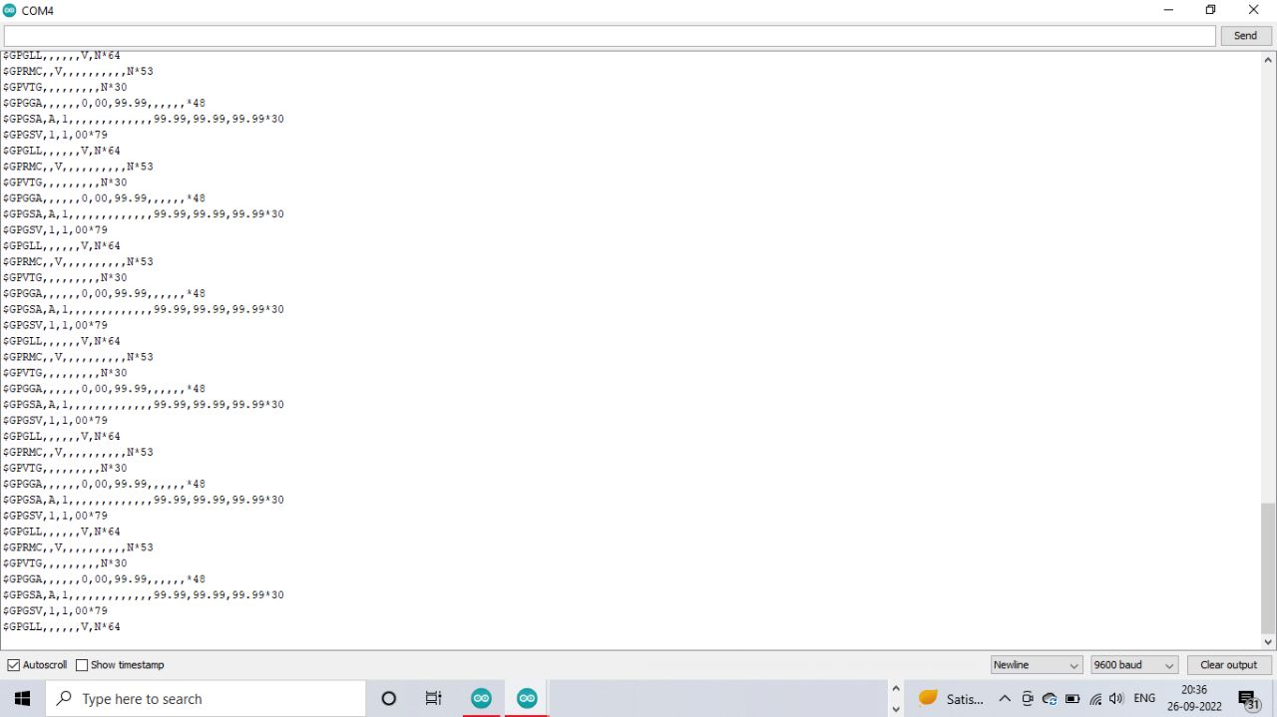
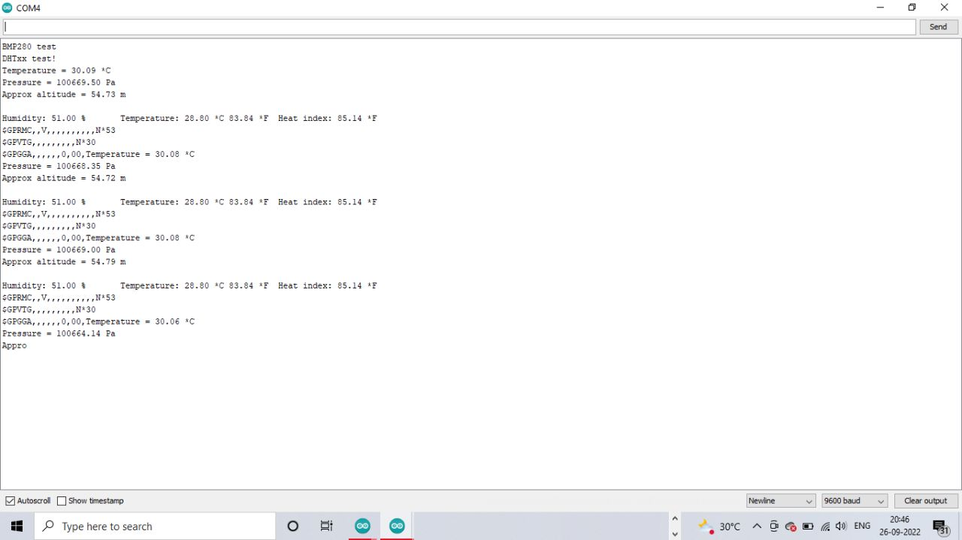
OUTPUT

Slide 8

Hello Everyone, this is my community and underground metro pipe line system.
This Photo by Unknown Author is licensed under CC BY-NC

Slide 9


I am an engineer, I am here to look into the problem
But we are facing problems in our water supply

Slide 10



We may have an solution to your problem
I need to find a suitable device to detect the problem

Slide 11
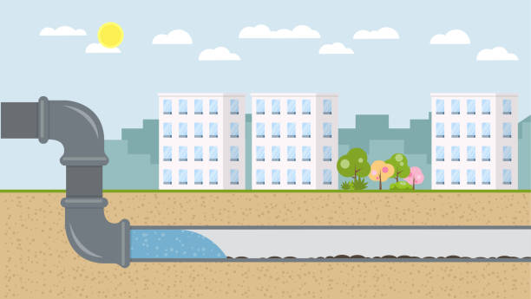


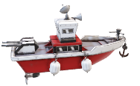
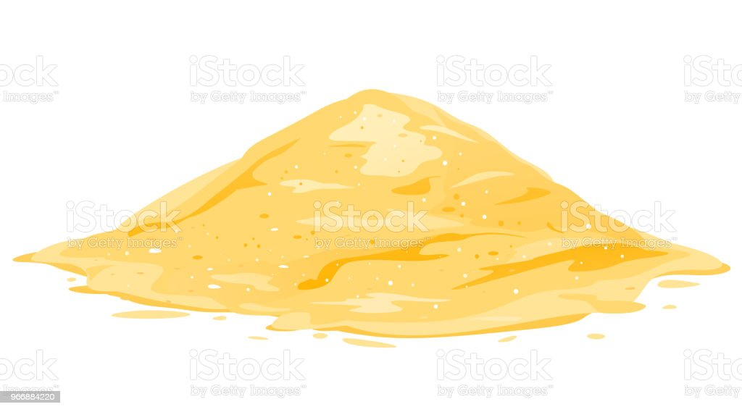
I am here to control the Navi-log craft

Slide 12

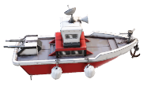
I have successfully detected the clog and located the leak

Slide 13
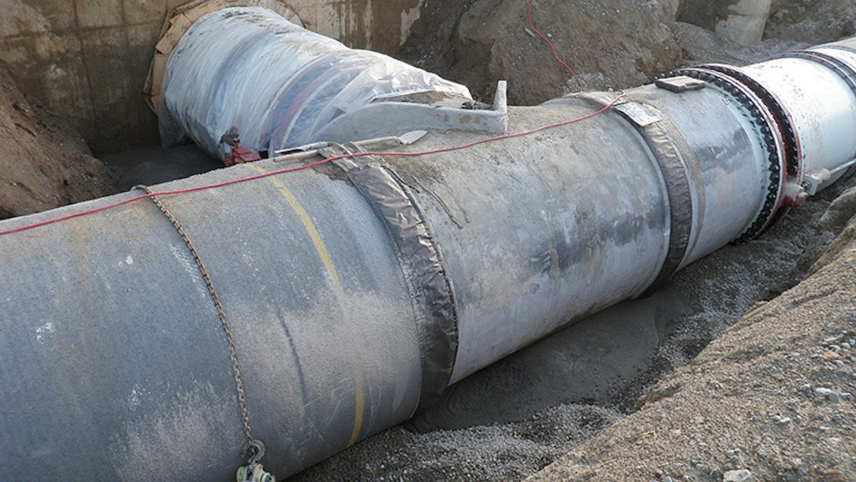
The most common pipe diameter for water mains is 6 to 16 inches
What is the size of water supply pipe in India?
The CPVC plumbing pipes are available in sizes from 15mm (1/2") to 50mm (2") conforming to IS 15778 in SDR 11 & 13.5 classes. CPVC pipes are also available in 'Iron Pipe Size' (IPS) from 65mm (2 1/2") to 150mm (6") in Schedule 40 and Schedule 80 series which meet the requirements of ASTM F 441.
ASTM F441 is the Standard Specification for CPVC Plastic Pipe, Schedules 40 and 80. Per the standard's requirements and test methods, CPVC is assessed for “materials, workmanship, dimensions, sustained pressure, burst pressure, flattening and extrusion quality.”
Chlorinated polyvinyl chloride (CPVC) is a thermoplastic produced by chlorination of polyvinyl chloride (PVC) resin. CPVC is significantly more flexible than PVC, and can also withstand higher temperatures. Uses include hot and cold water delivery pipes and industrial liquid handling. CPVC, like PVC, is deemed safe for the transport and use of potable water

Slide 14
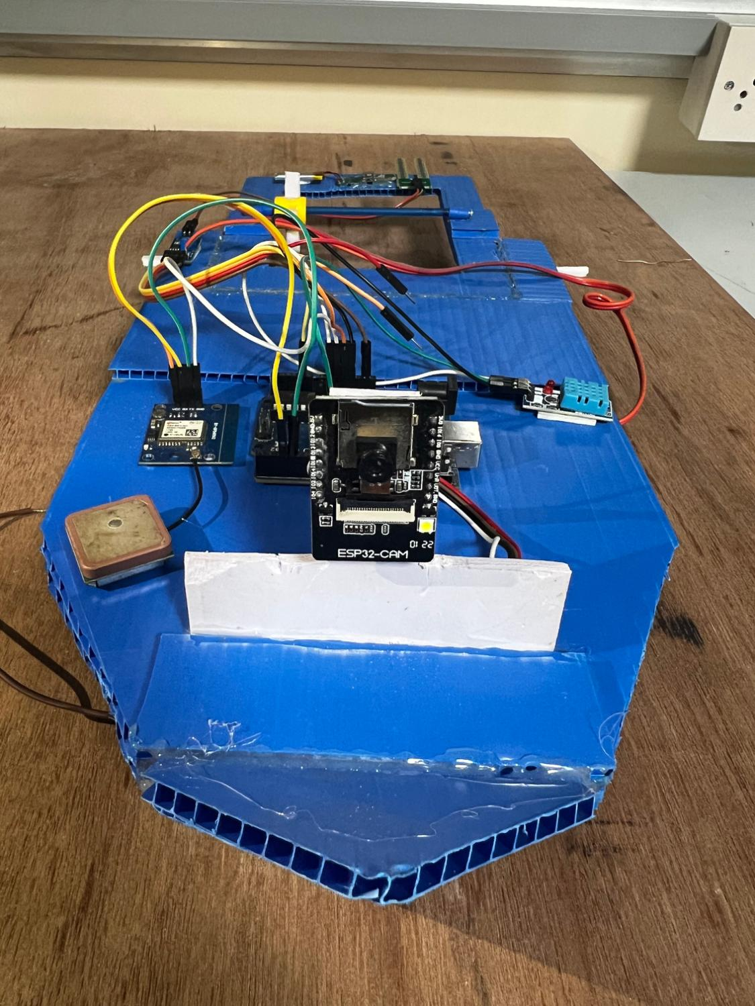
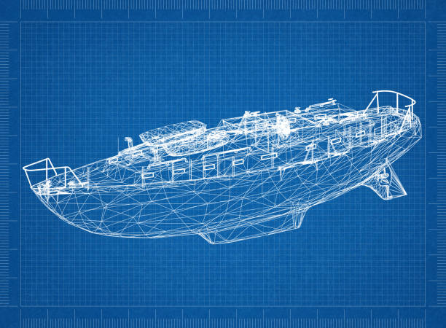
High-strength alloyed steel is still the main material for submarines today, with 250–350 metres (820 to 1,148 feet) depth limit, which cannot be exceeded on a military submarine without sacrificing other characteristics. To exceed that limit, a few submarines were built with titanium hulls. Titanium has a better strength to weight ratio and durability than most steels, and is non-magnetic. Either we can use the titanium mount or polymer casing.
It’s laminated or coated with a waterproofing material such as rubber, polyvinyl chloride (PVC), polyurethane (PU), silicone elastomer, fluoropolymers, and wax.

Slide 15
FUTURE ENHANCEMENTS
In the future the device will be equipped with high end camera thereby it will transmit the live feed to the controller on the road
The device will be made with completely non corrosive material and be completely sealed to prevent any entry of water into the system.
Telescopic wheels will be attached to the structure which will help the device to navigate even in dry conditions.

Slide 16
THANK YOU

